Slide 1
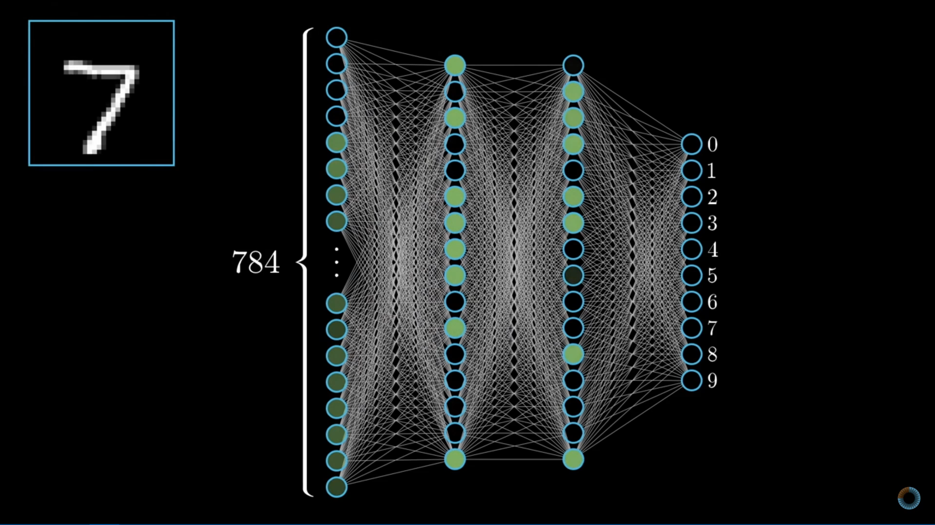
The input is then given a forward pass where each Layer’s corresponding weights and biases perform a given mathematical function.
Credits : 3Blue1Brown on YouTube

